Slide 1
Building your first EMG amplifier (supplementary)
Mikhail Sintsov
Head of Human-Machine Interfaces at Motorica LLC

Slide 2
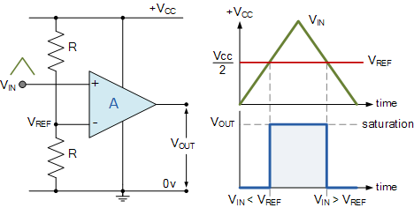
Basic principles — building intuition
Open Loop Gain ~ 1e6
(коэффициент усиления открытой/разомкнутой цепи/петли)
//wiki

Slide 3
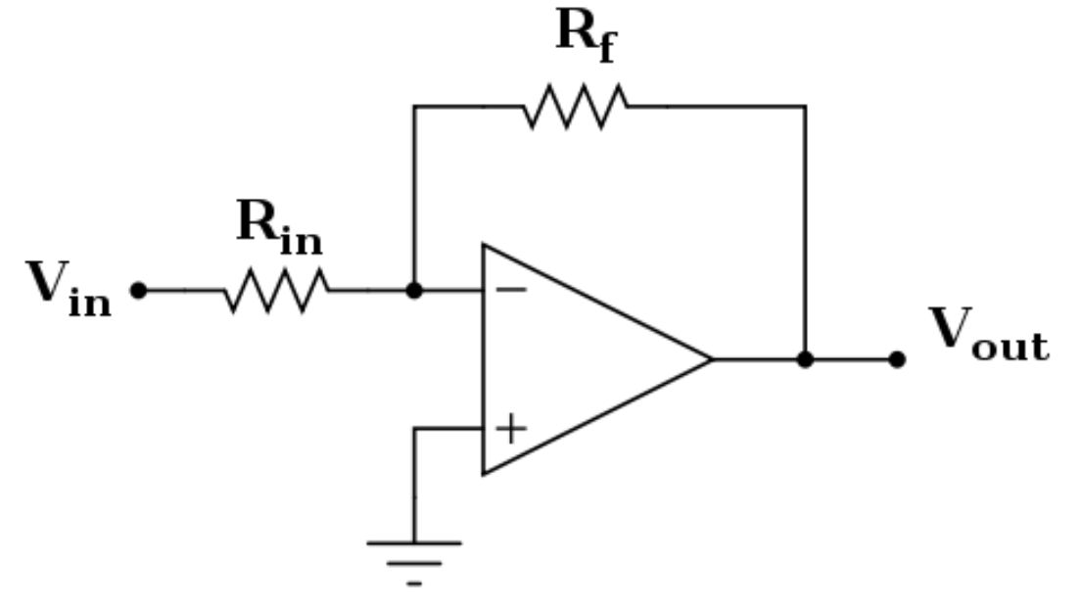
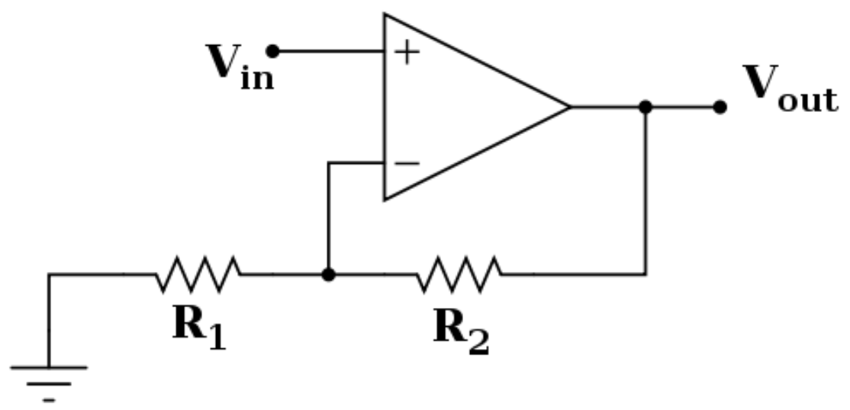
Feedback — building intuition
Non-inverting amplification
(неинвертирующий усилитель)
Inverting amplification
(инвертирующий усилитель)

Slide 4
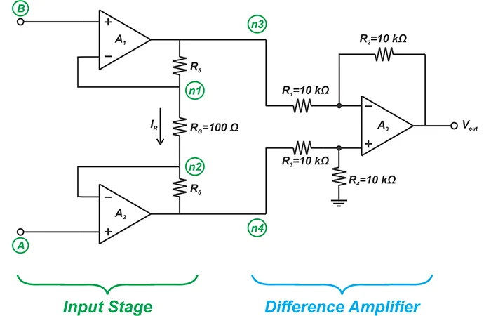
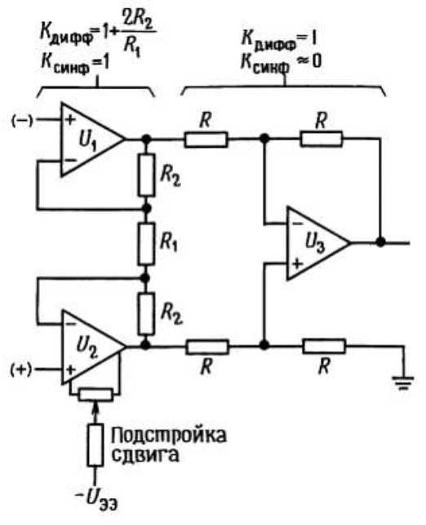
Three-OpAmp model — building intuition
Хоровиц, Хилл — Искусство Схемотехники,
4-е изд, 2 том
https://www.allaboutcircuits.com/technical-articles/learn-about-three-op-amp-instrumentation-amplifiers/

Slide 5
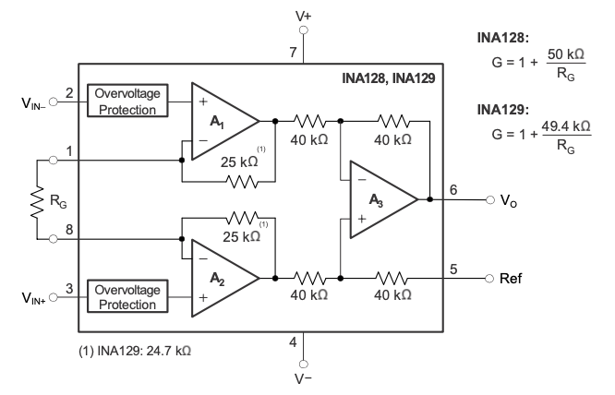
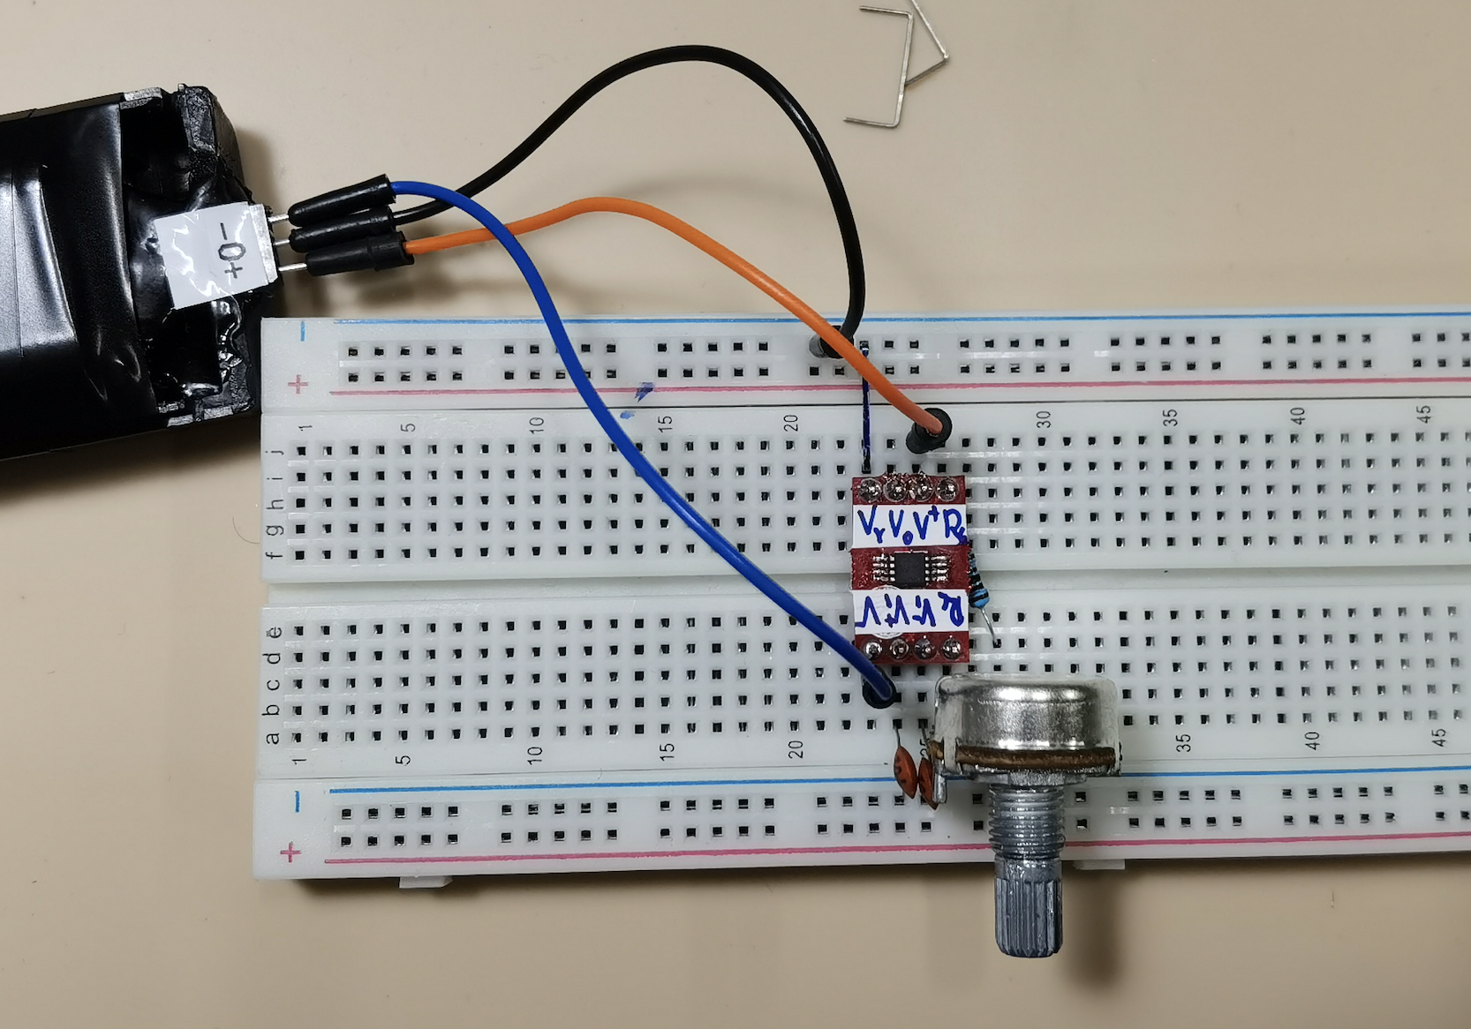
Analog connection — simplest bipolar connection

Slide 6
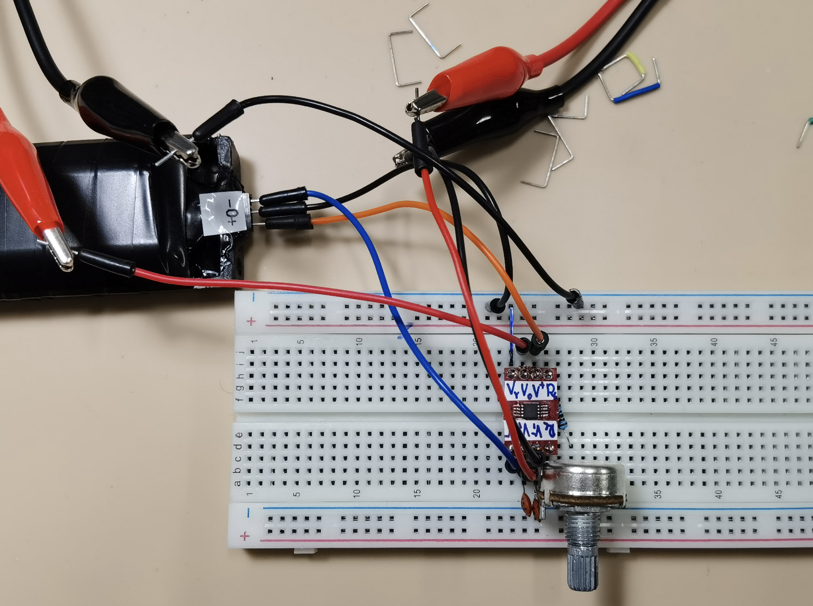
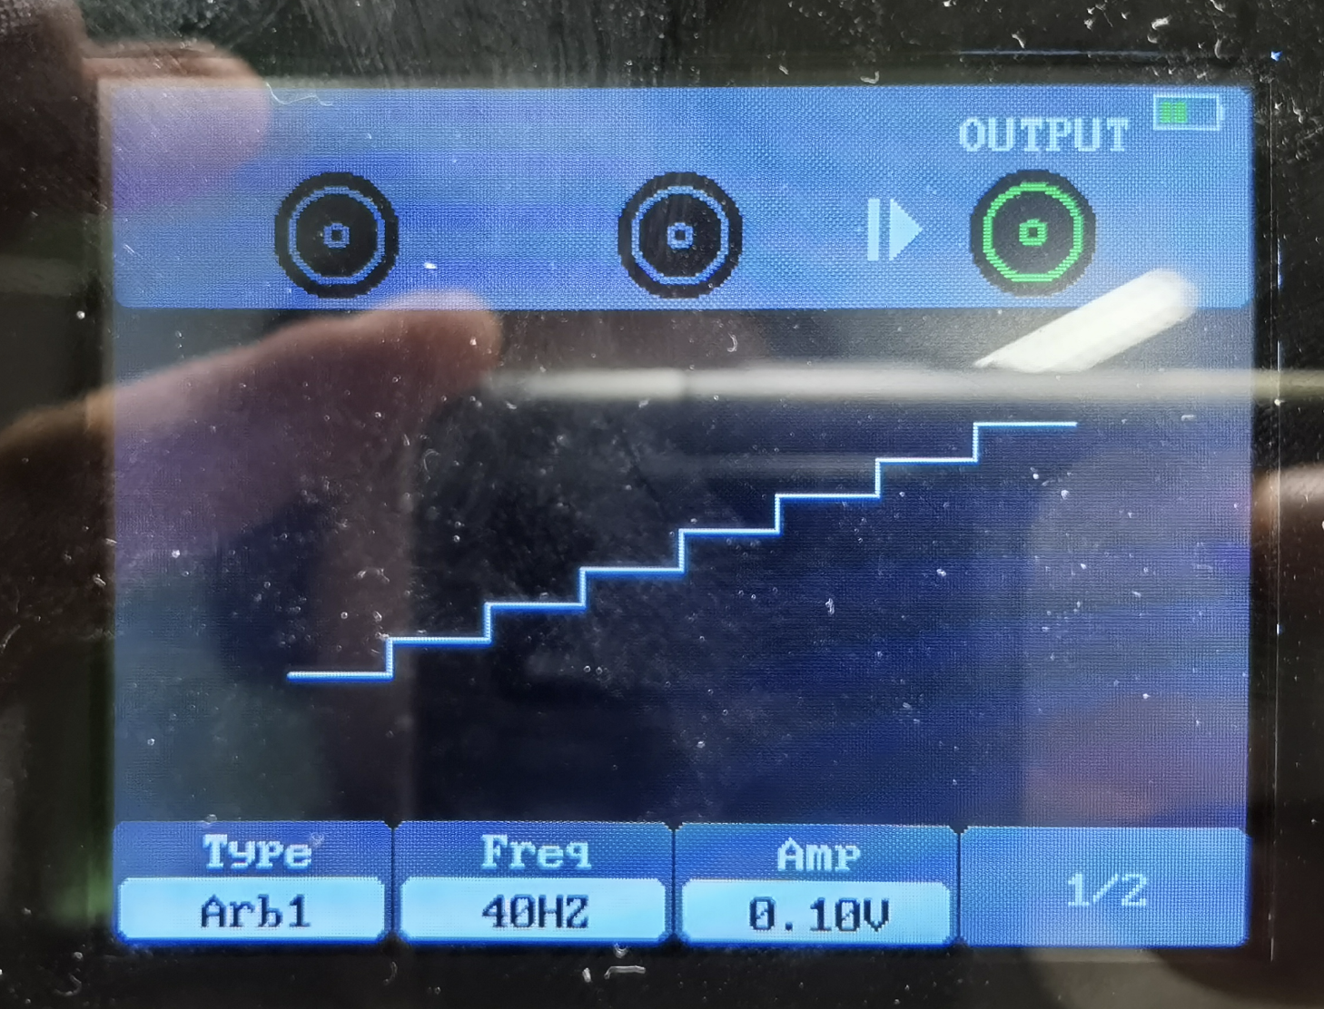
Analog connection — AWG connection

Slide 7
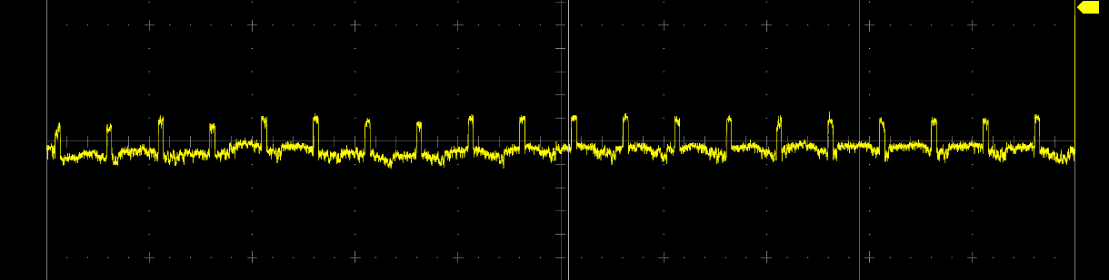
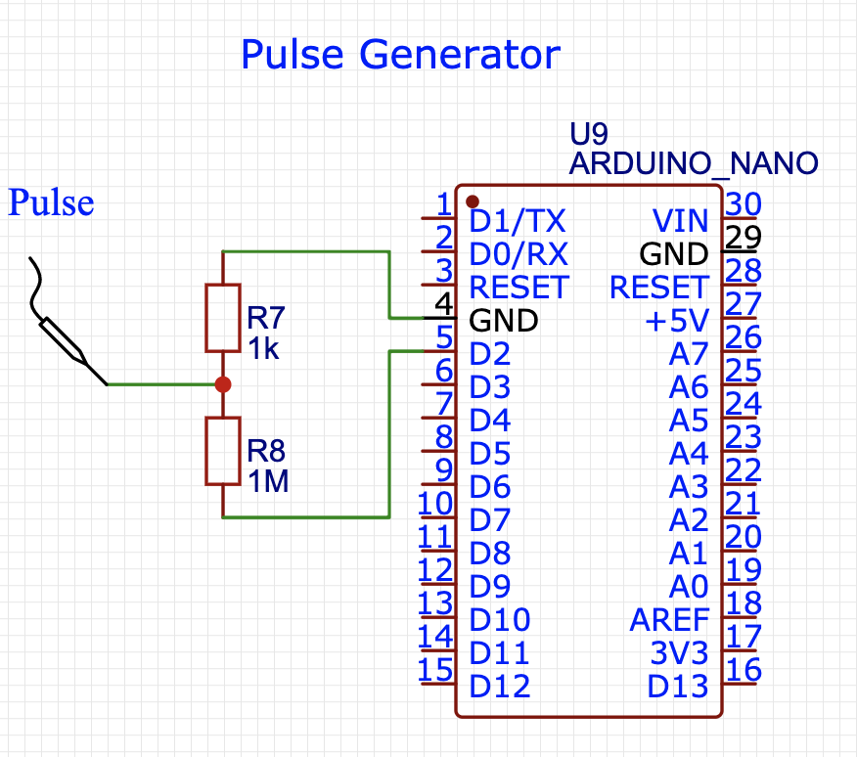
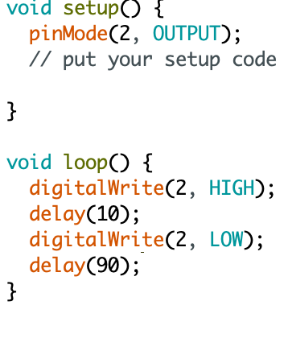
Pulse generator (if you don’t have any)
Amplitude = 5mV
Frequency = 10Hz
Duty Cycle = 10%

Slide 8
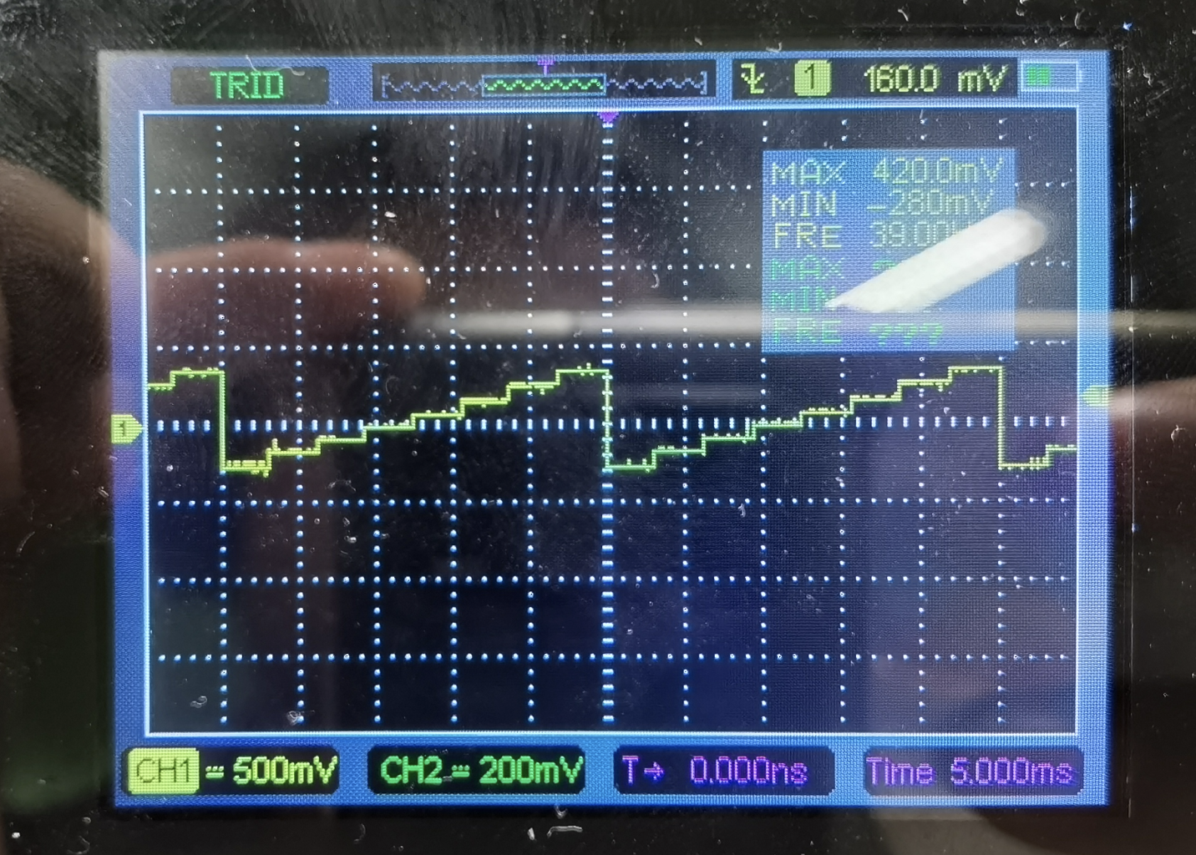
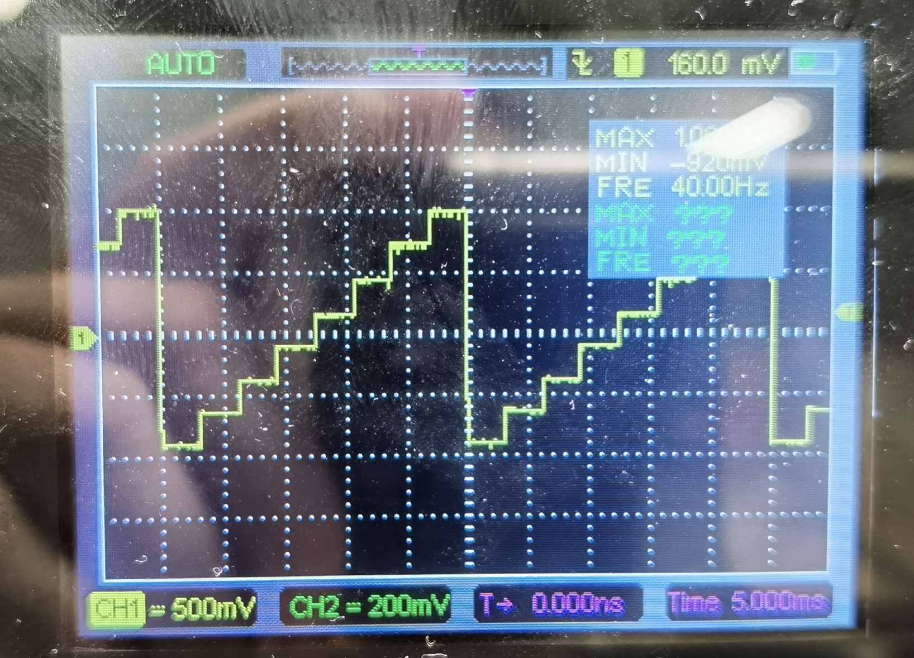
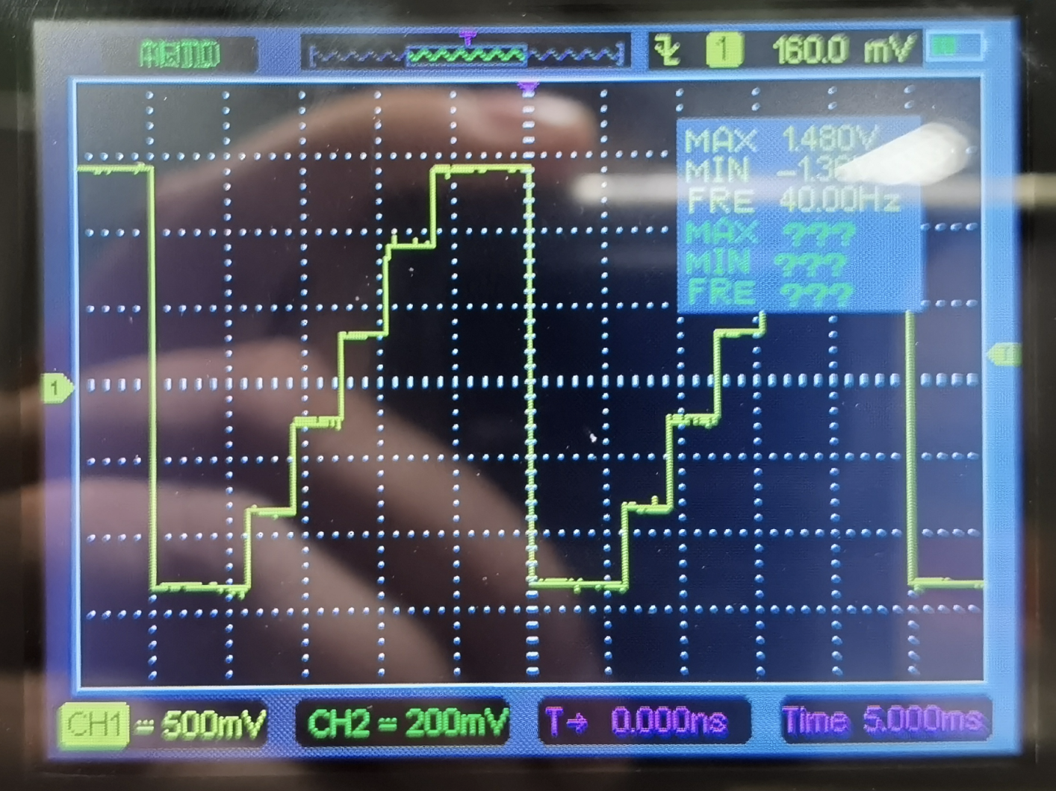
Analog connection — increasing gain, clipping effects

Slide 9
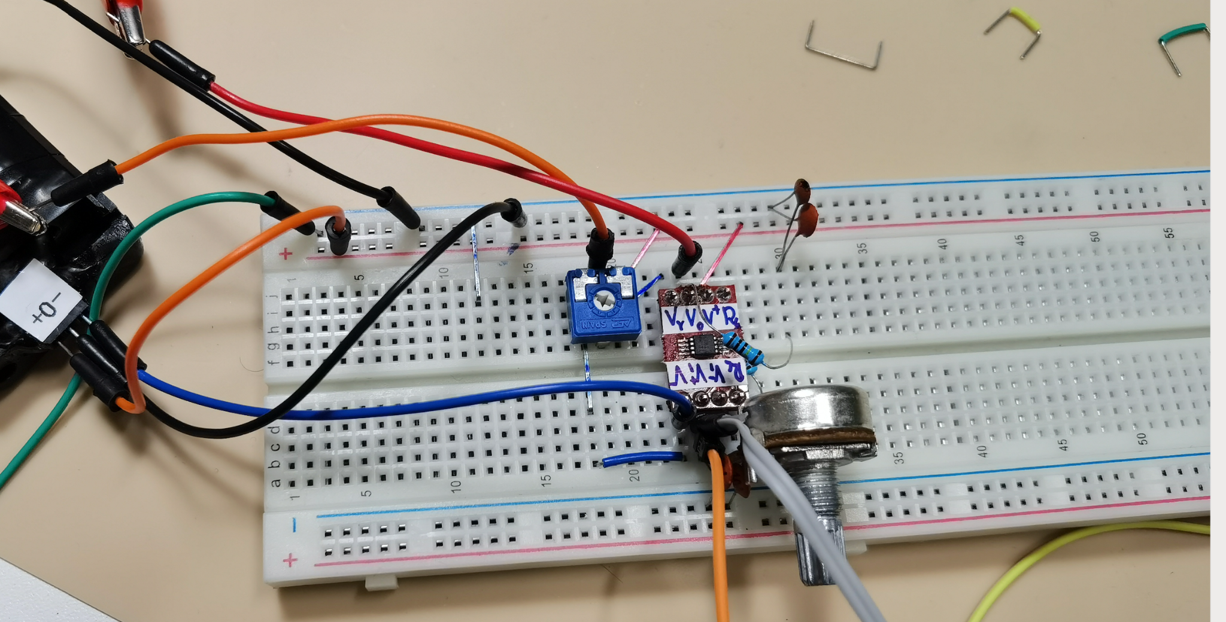
Analog connection — ref shift

Slide 10
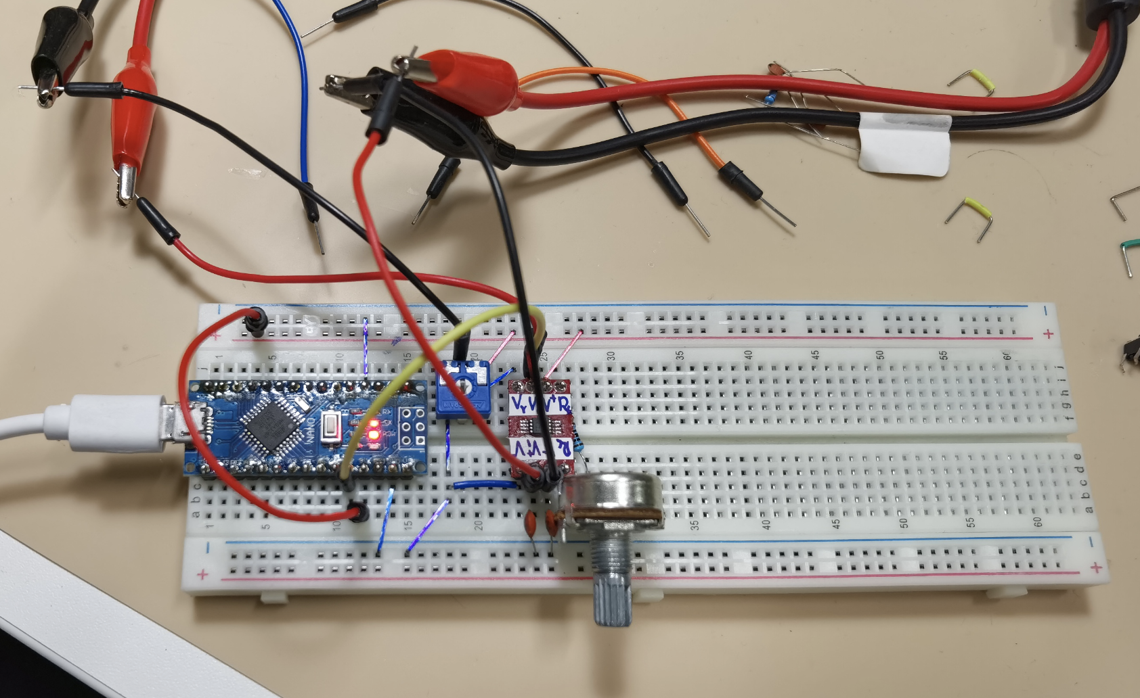
Arduino Digitization — connection

Slide 11
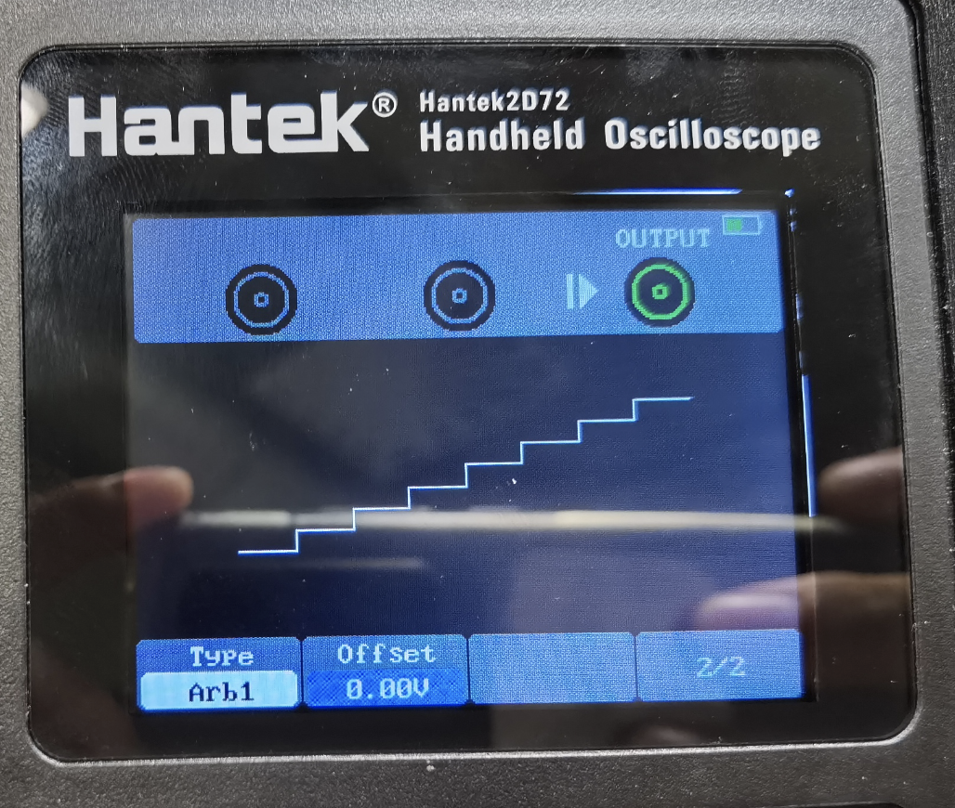
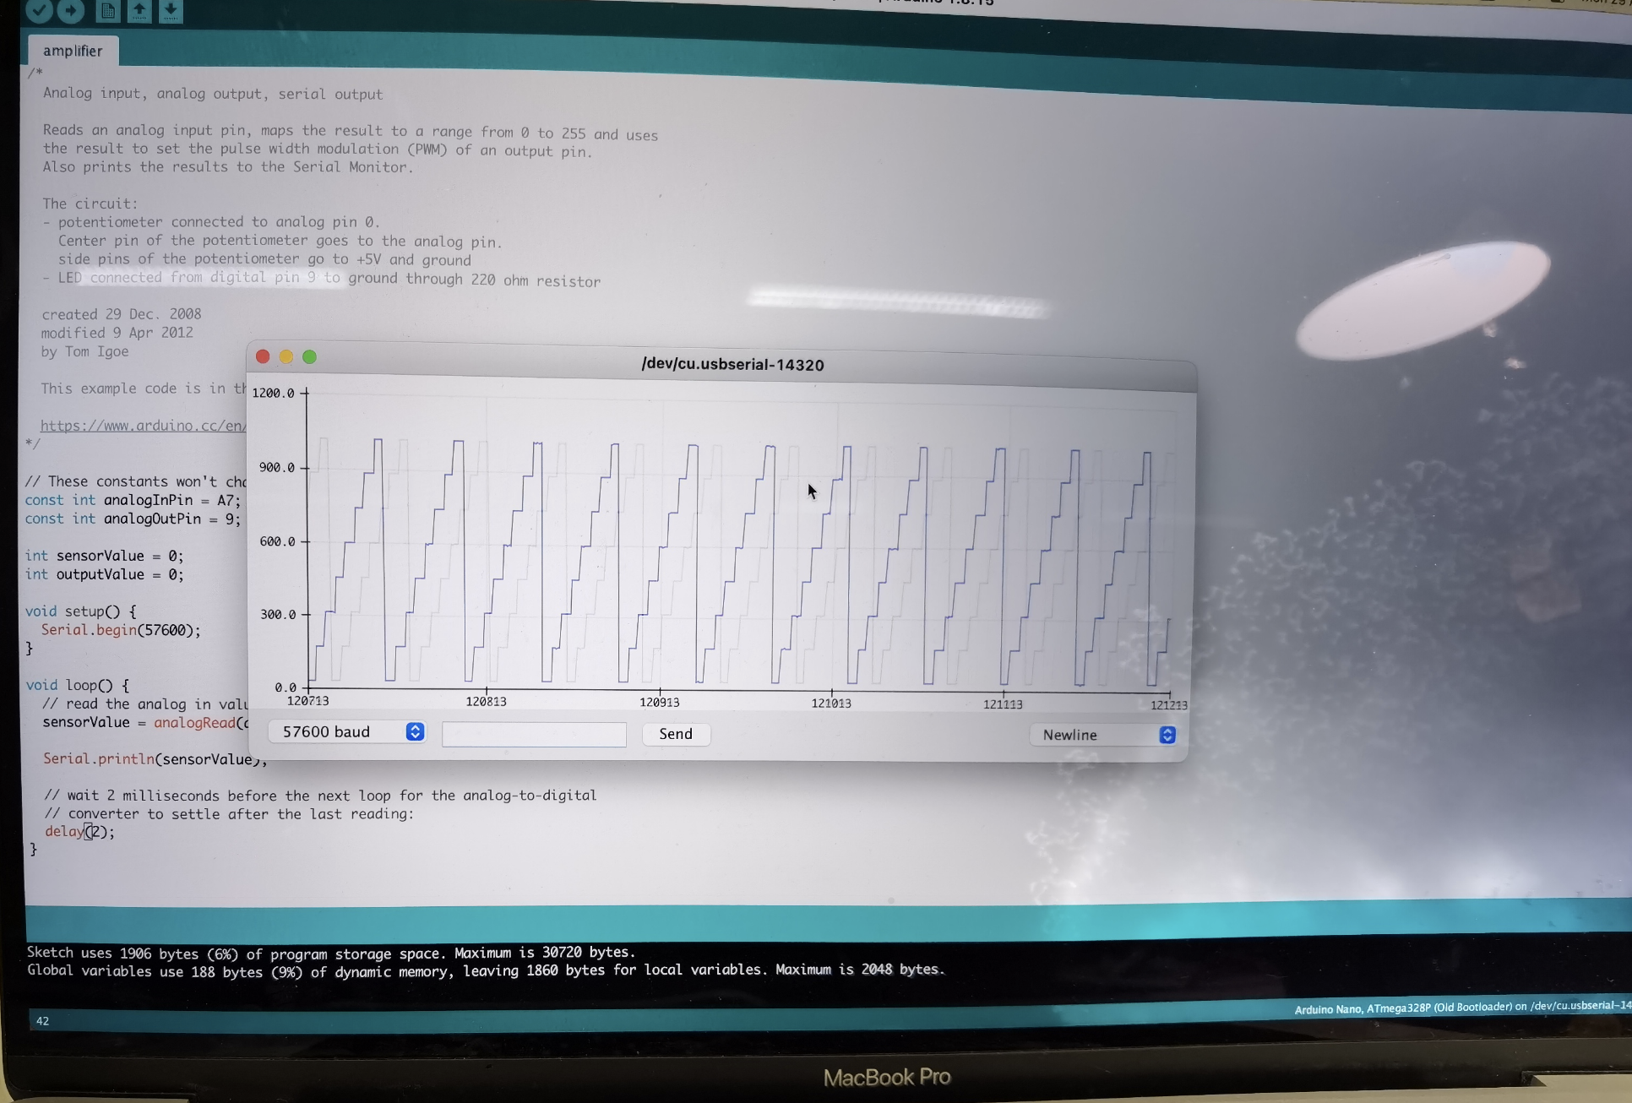
Arduino Digitization — sample waveform

Slide 12
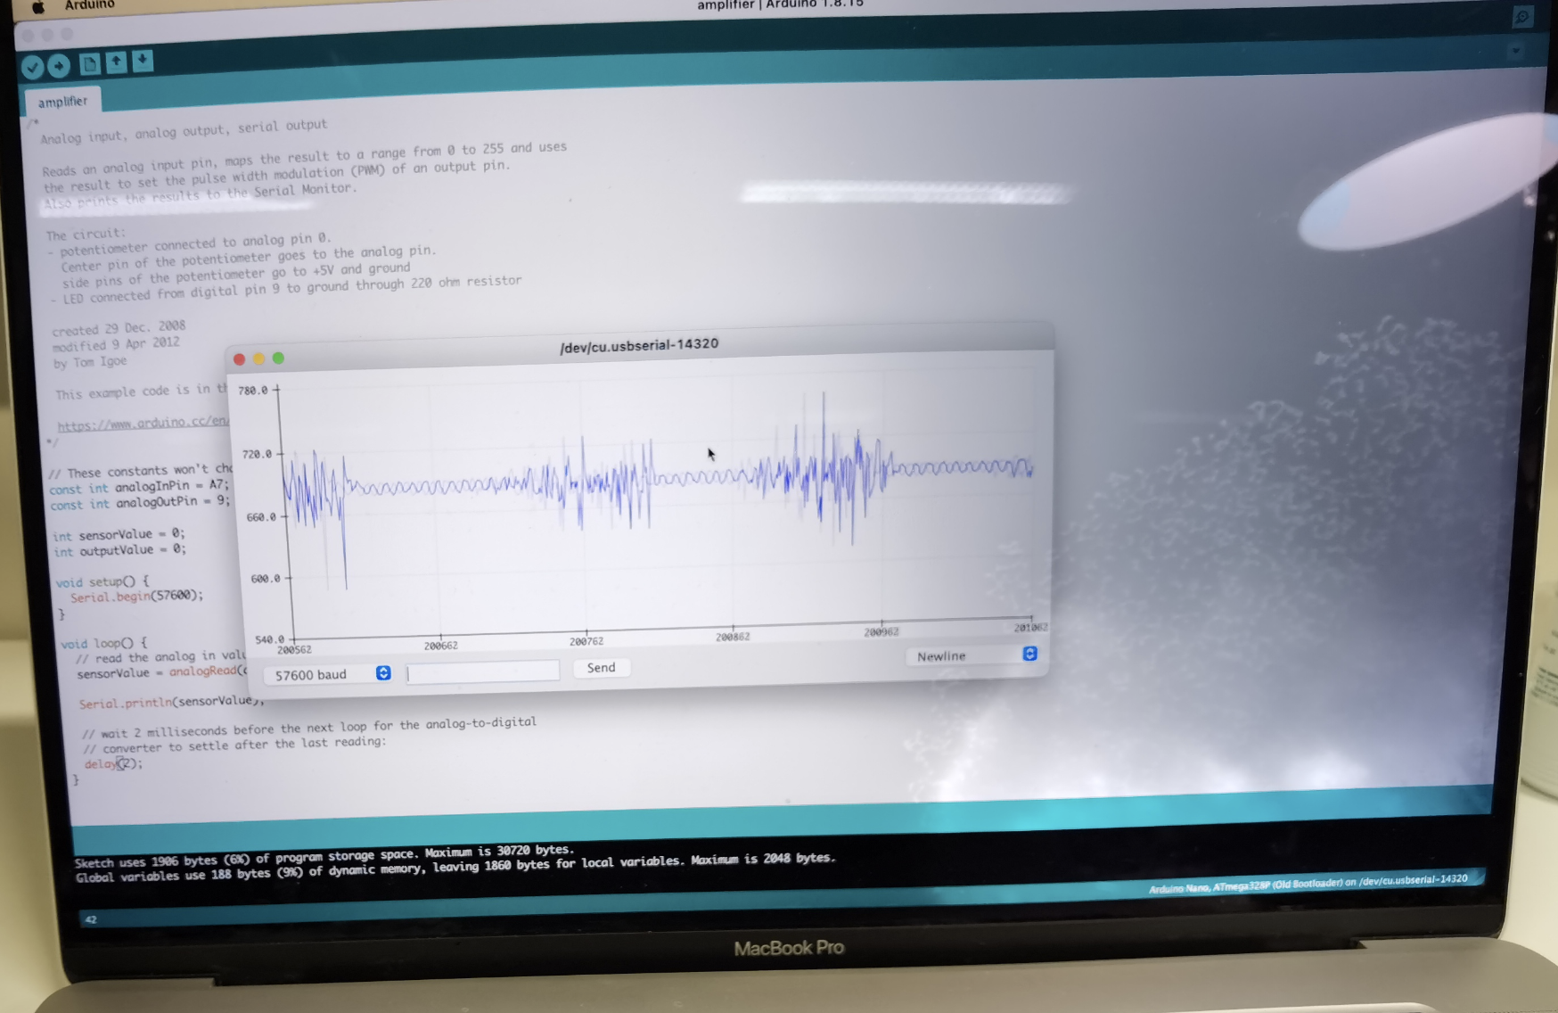
Arduino Digitization — EMG signal

Slide 13
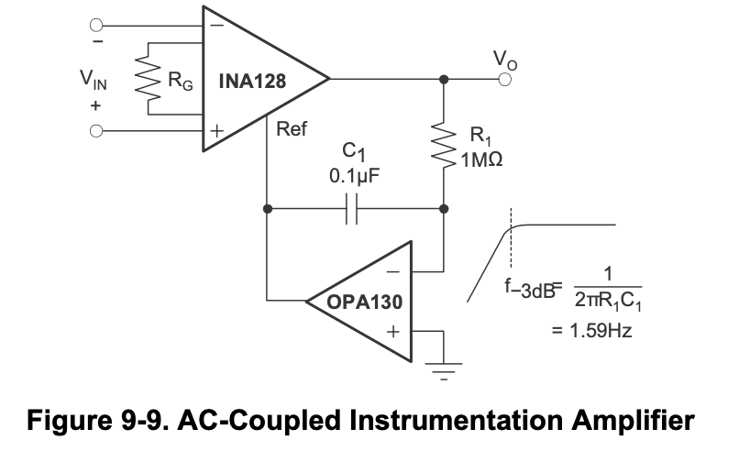
High-pass filtering — building intuition

Slide 14
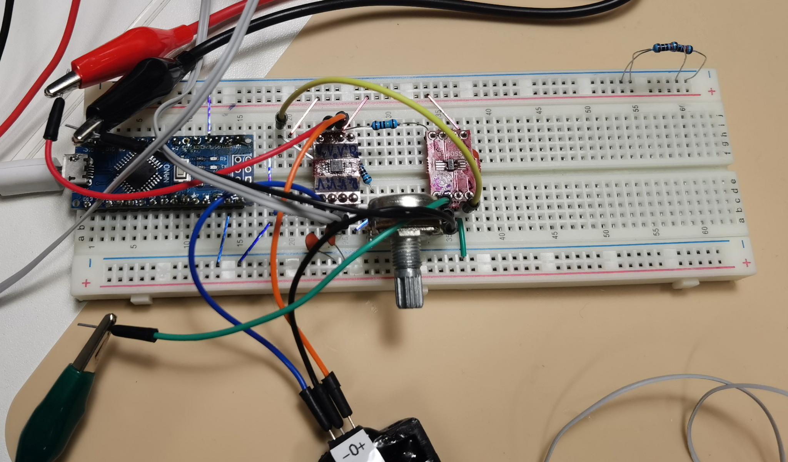
High-pass filtering

Slide 15
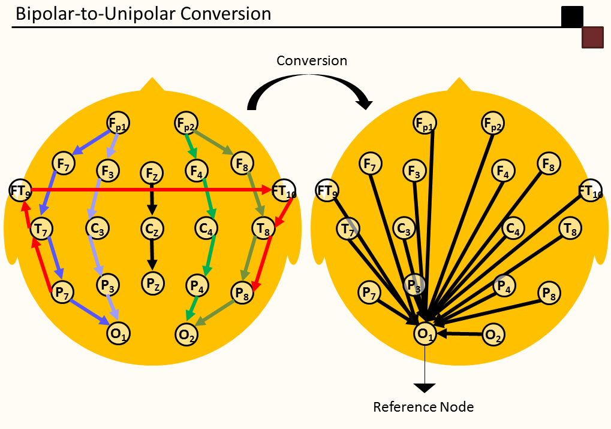
EMG preprocessing and Envelope connection
Huge problem in naming Reference vs (Patient) Ground
Lets state that
Reference Electrode — the common differential input (Vin+, or Vin- INA333)
Ground — electrode for rejecting mutual potential (REF pin in INA333)
See also: https://www.biopac.com/knowledge-base/ground-vs-reference-for-eeg-recording/

Slide 16
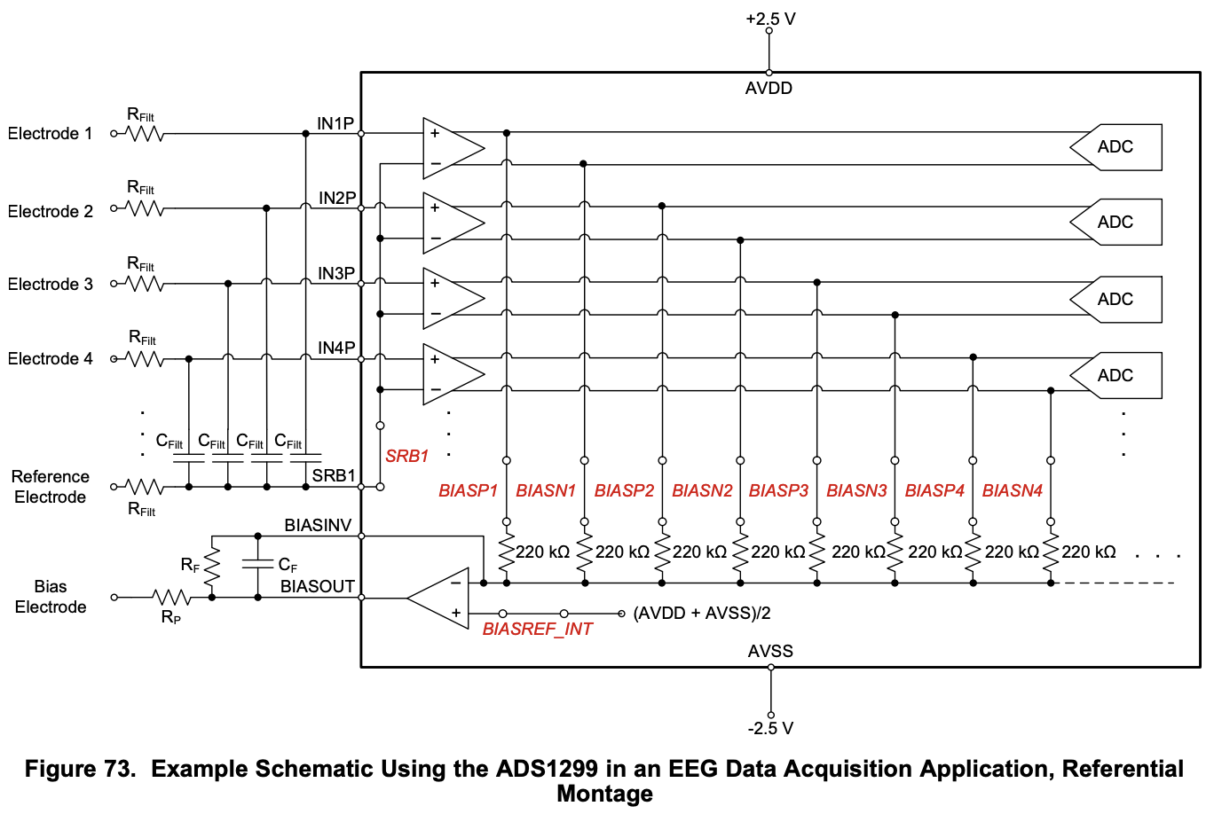
How Reference Montage could be implemented?

Slide 17

Next steps
Paul Horowitz & Winfield Hill — THE ART OF ELECTRONICS Third Edition
Datasheets: INA129/333
See a jupyter notebook on EMG envelope calculation

Slide 18
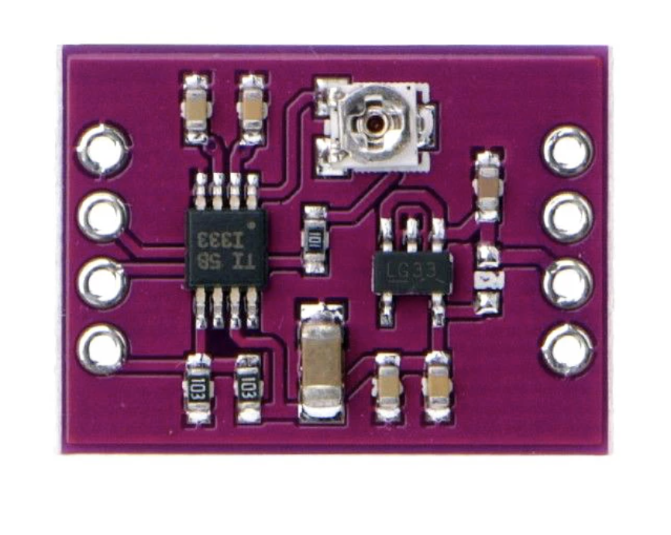
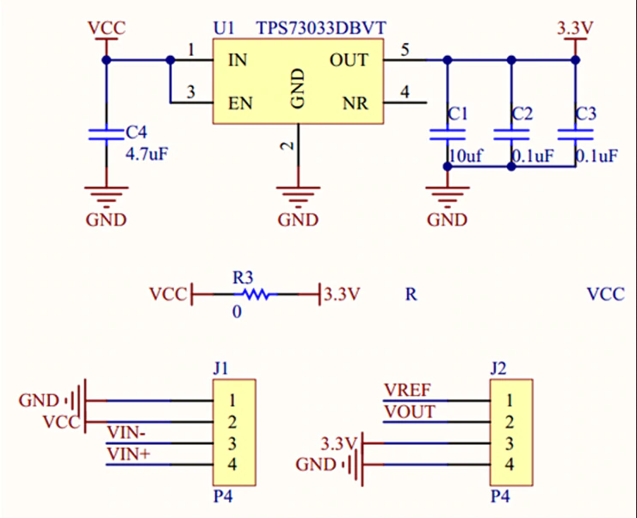
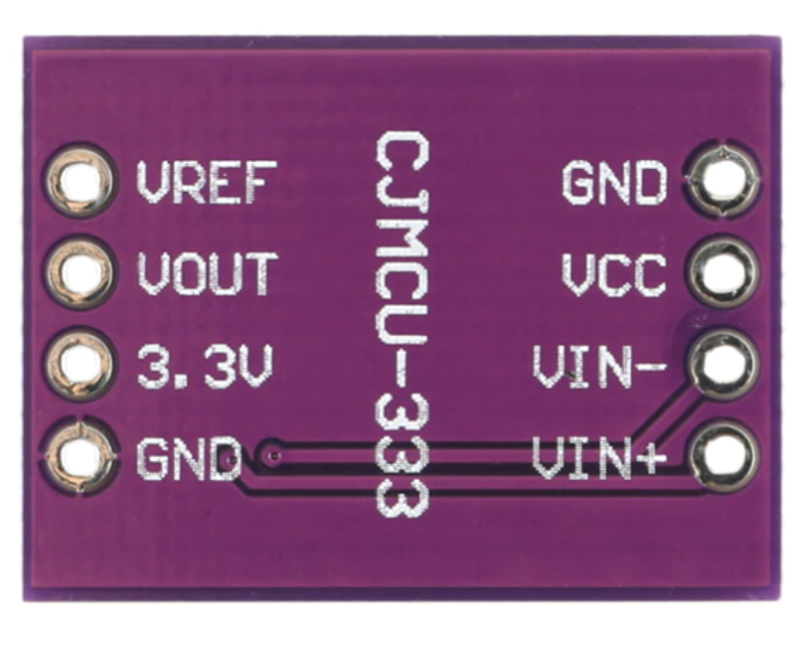
INA333 additional info: power connection

Slide 19
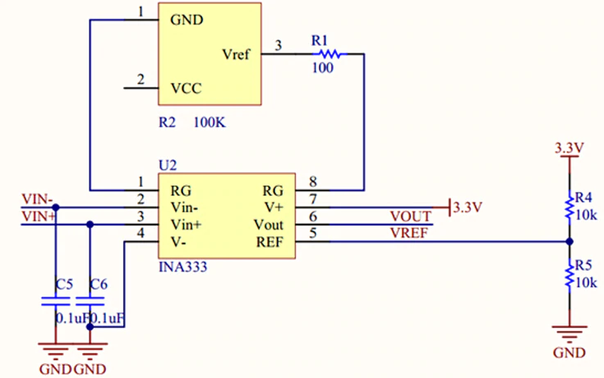
INA333 additional info: INA333 connection

